Slide 1

Analysis and Insights: Patterns Of Social Assistance Utilization Over Time
Derrick Kessie

Slide 2
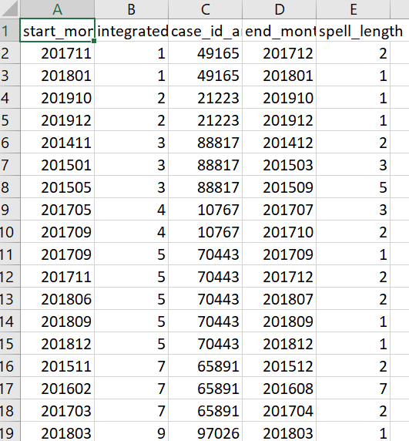
QUESTION 1

Slide 3
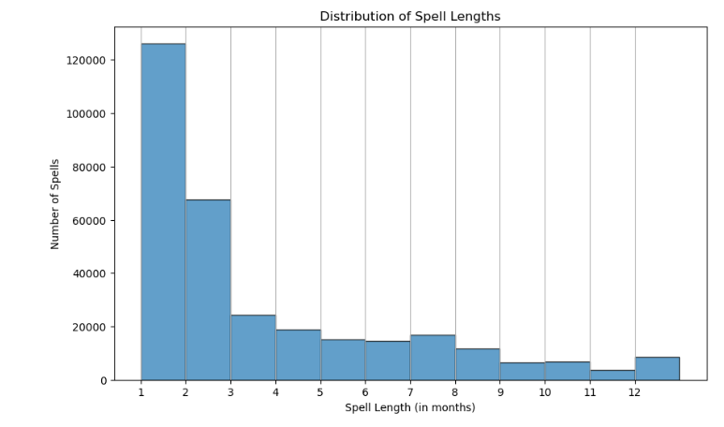
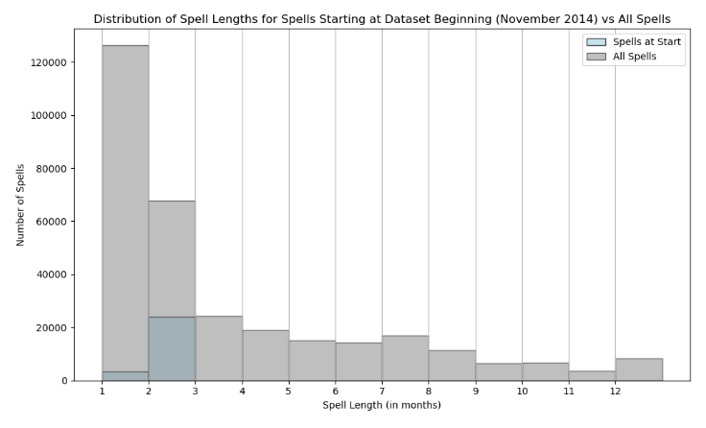
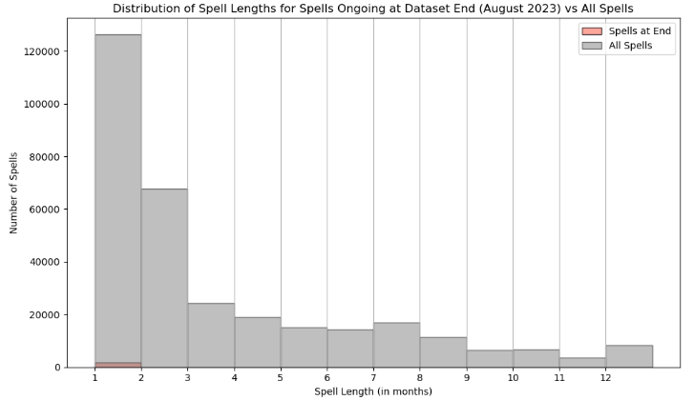
Question 2

Slide 4
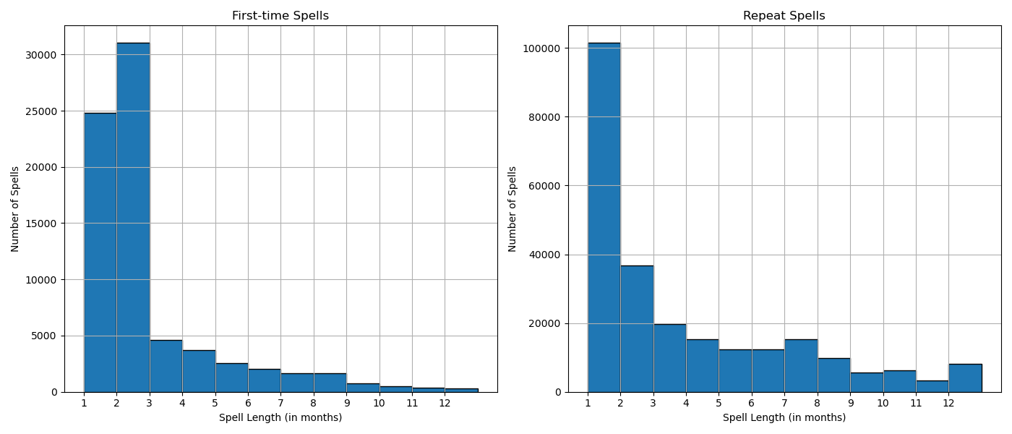
QUESTION 3

Slide 5
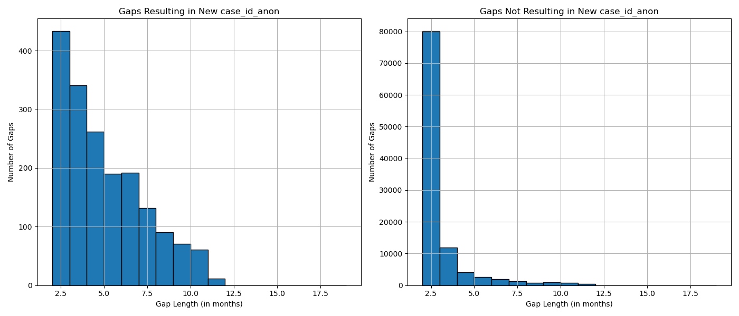
QUESTION 4

Slide 6
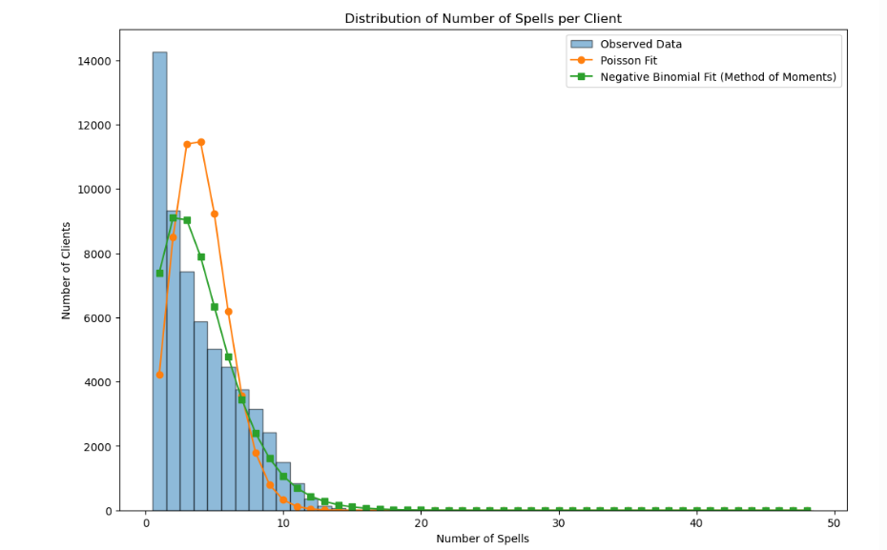
QUESTION 5

